Slide 1
Methodology
Database System Development Lifecycle of Connolly and Begg.
5 Phases:
  Database Planning
  System Definition Requirement Collection and Analysis
  Conceptual Model
  Logical Model
  Physical Model

Slide 2
Database Planning
Mission Statement
  The purpose of the Fantasy Soccer database is to deliver the back end of a soccer fantasy league which allows users to create and manage fantasy soccer teams and fantasy soccer leagues.
Mission Objectives
  Create and manage user data.
  Create and manage fantasy soccer teams.
  Create and manage fantasy soccer leagues.
  Browse and maintain player statistics.

Slide 3
System Definition
Main Actors and Roles (User Views)
  Team Manager: Creates and manages fantasy soccer team.
  League Commissioner: Creates and manages fantasy soccer league.
  System Administrator: Uploads game data; maintains system.
  User/Viewer

Slide 4
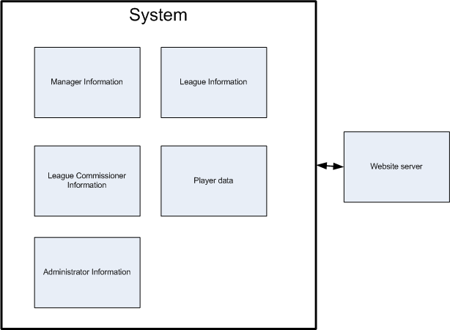
System Boundary

Slide 5
Requirements Collection and Analysis
Fact-Finding Techniques:
  Research/Interview
  Participate in existing Fantasy Soccer Leagues.
    http://fantasy.premierleague.com/
    http://uk.premiership.fantasysports.yahoo.com/

Slide 6
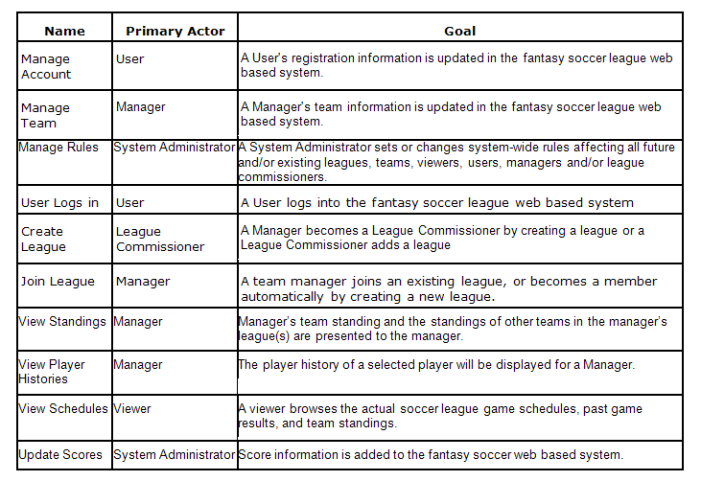
Use Case Summary

Slide 7
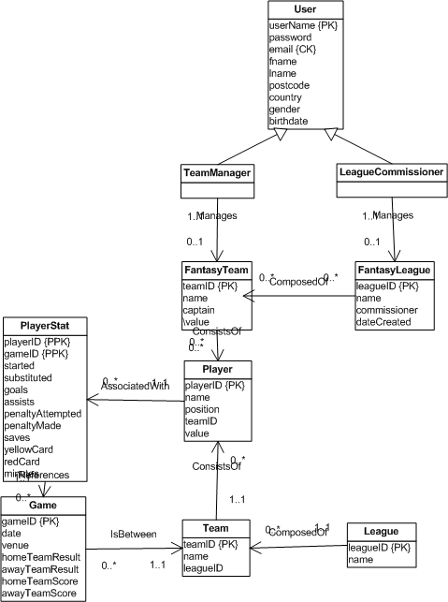
Conceptual Model (Team Manager View)

Slide 8
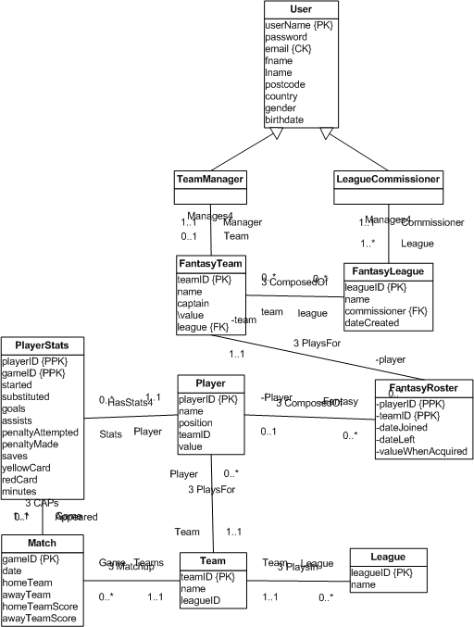
Conceptual Model (League Commissioner View)

Slide 9
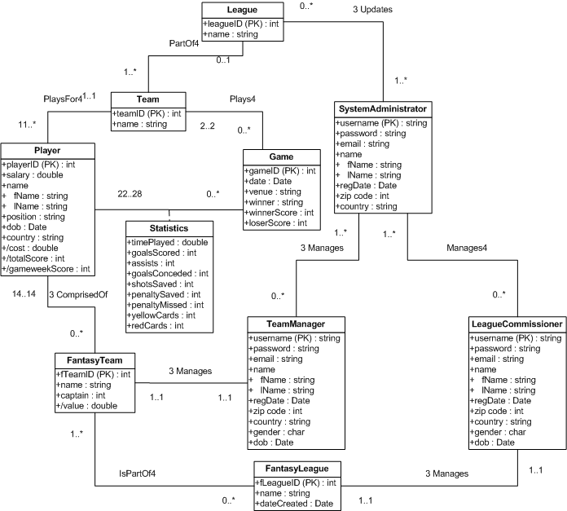
Conceptual Model (System Administrator View)

Slide 10
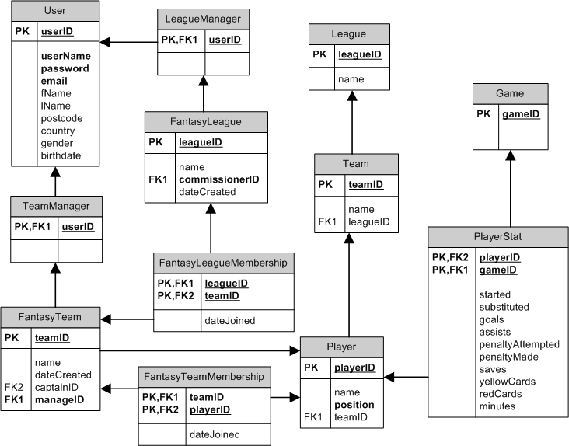
Logical Model (Team Manager View)

Slide 11
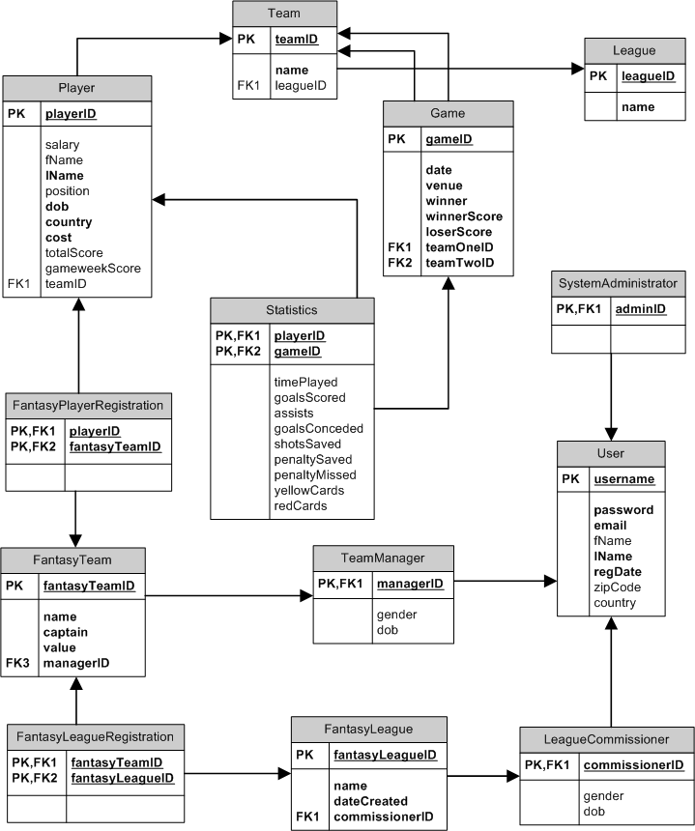
Logical Model (League Commissioner View)

Slide 12
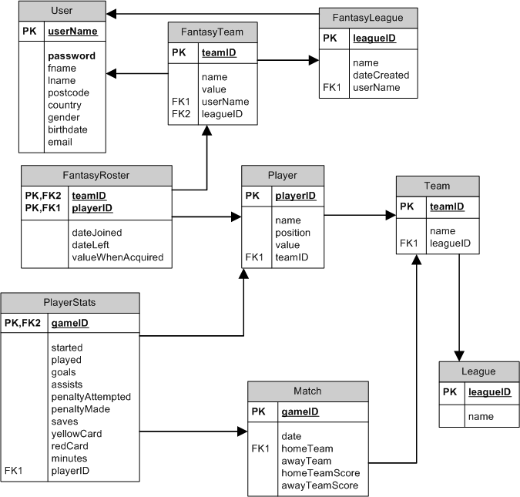
Logical Model (System Administrator View)

Slide 13
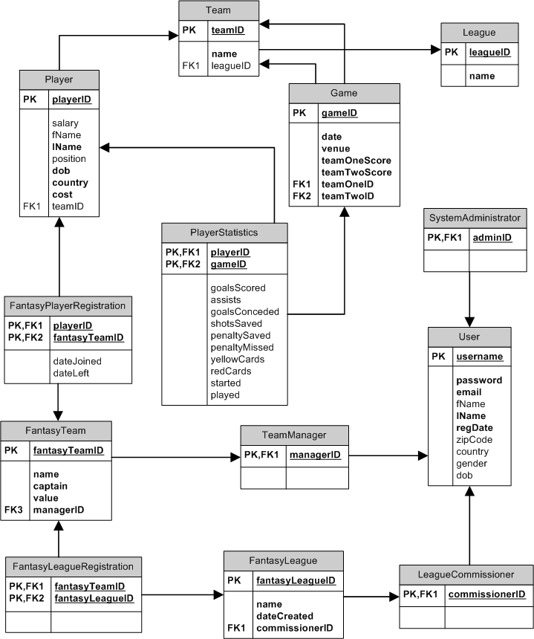
Global Logical Model

Slide 14
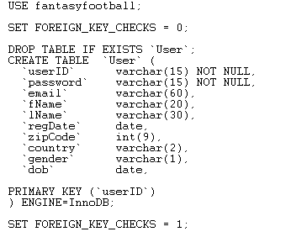
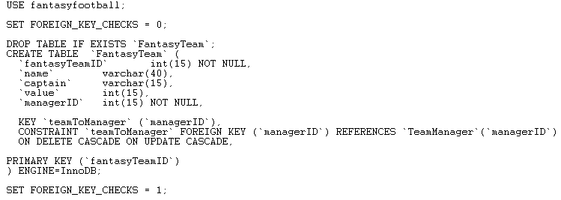
Physical Model

